Slide 1
FFT Overflows
Bronwyn Curnow

Slide 2
What are FFT Overflows?
The F-engine records the time-stream voltages with 8-bit precision. (The F-engine works with real time processing).
These time-streams are then FFT’d (Fast Fourier Transform) to form complex frequency-space voltages.
The output of the FFT has 18-bit precision.
If the voltage in any single frequency bin exceeds its 18-bit dynamic range, it has the potential to corrupt the entire band
There is bit-growth at each stage due to multiplication and addition of numbers. The earlier in the process the overflow occurs, the more frequency bins are affected.

Slide 3
How are FFT Overflows recorded?
FFT Overflows are stored in a database in ~50s intervals.
Intervals aren’t exactly 50s, but it’s the most accurate we can currently be.
To query for them, we use Prometheus and Victoria Metrics. (A tutorial for this is available on GitHub).
Overflows are recorded separately for each crate (8 in total).
Within the crate, they are stored by channel and slot number, 256 inputs in total (16 channels and 16 slots per channel)
Each of these 256 inputs has a counter value that can overflow anywhere from 0-255 times in each time interval. (The counter saturates at 255, it may be higher, we just don't know)

Slide 4
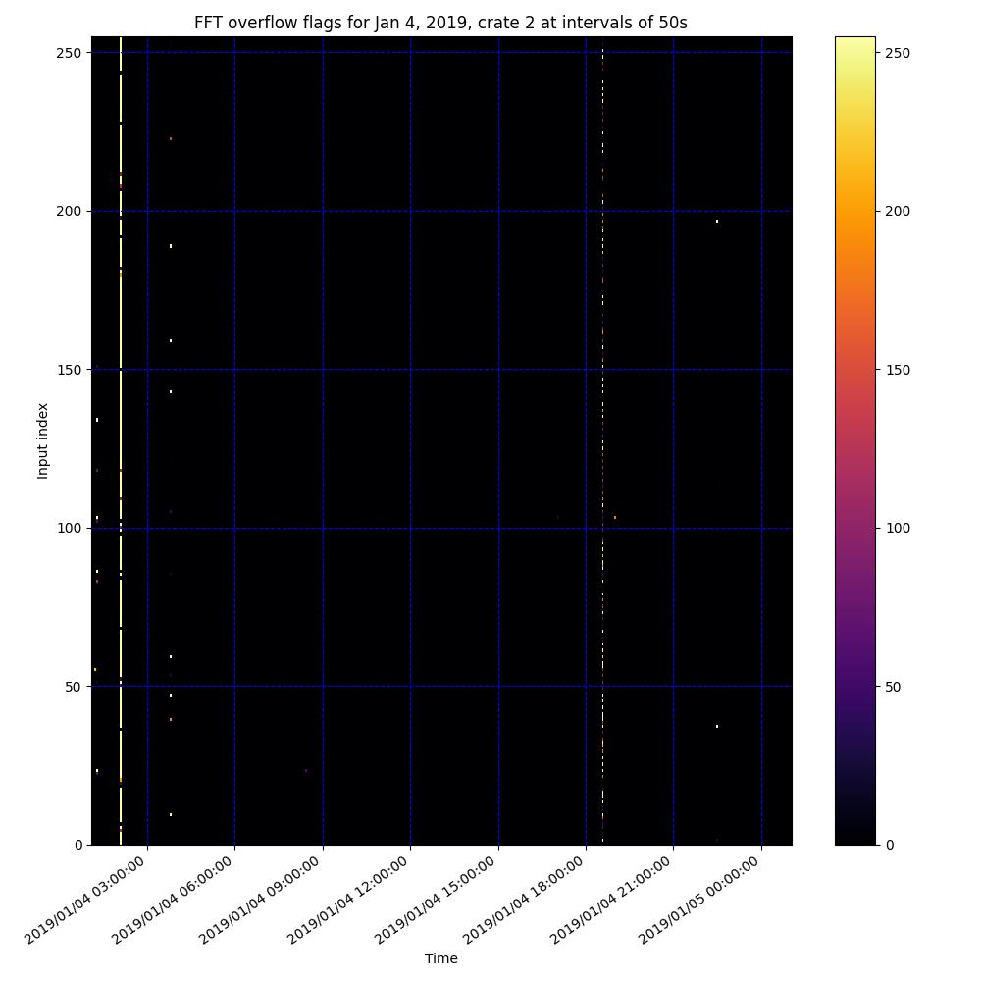
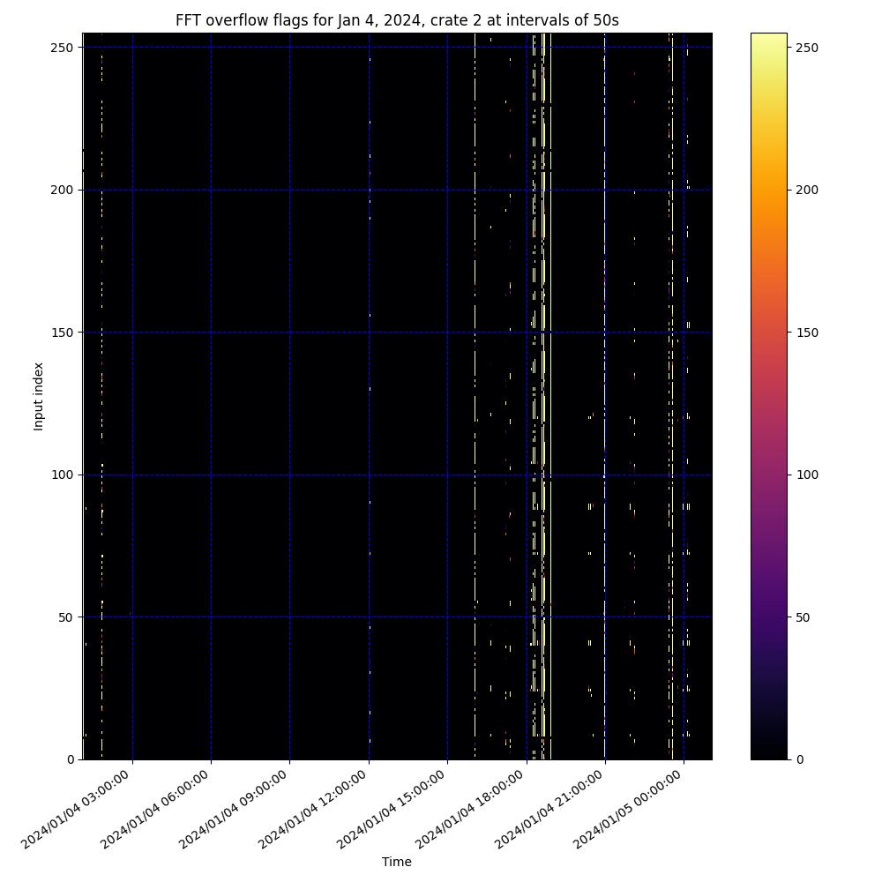
Example Graphs for FFT Overflows, from Crate 2 in January 2019 and January 2024
Roughly 3 times more overflows in 2024 than 2019!

Slide 5
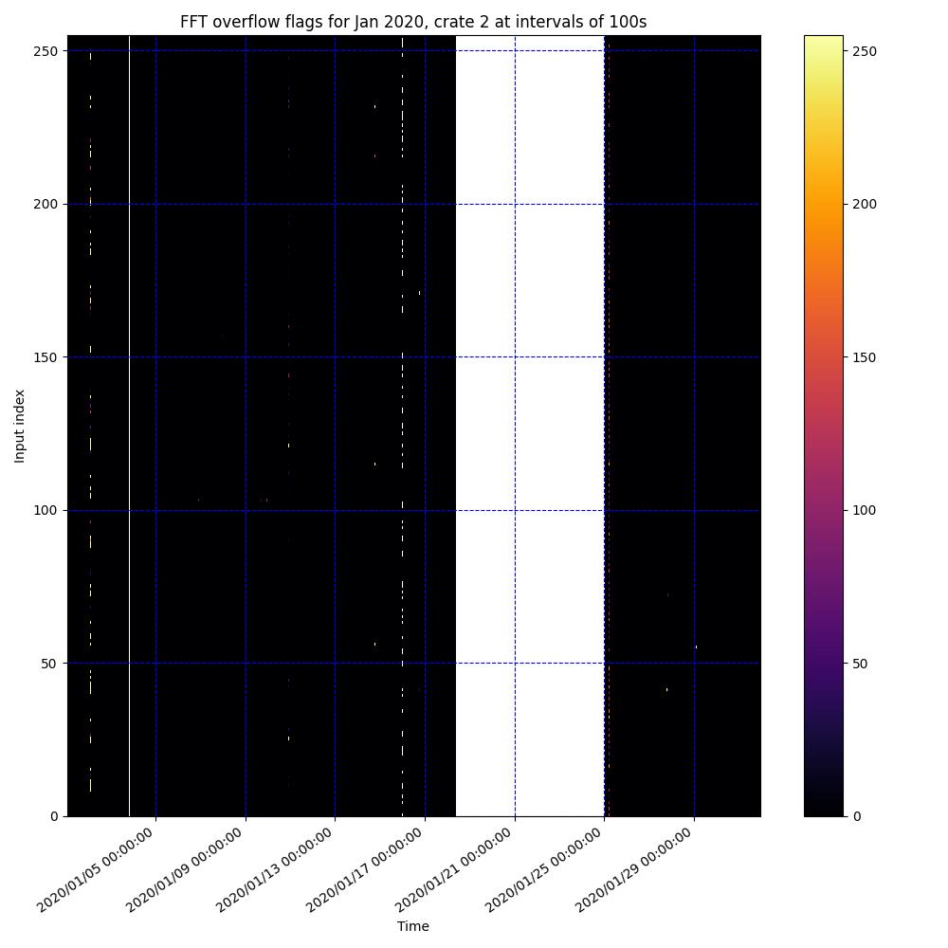
NAN’s
It should be noted that when querying for this FFT overflow data, the value nan is frequently returned as a counter value.
Roughly 10% of data is returned as nan. This is dragged upwards by long periods (ex. in January of 2020) where no data was returned at all for several weeks, corresponding to telescope issues.
The following statistics generally ignore nan values, since we have no data on the counter values at those points.

Slide 6
FFT Data from Jan 2019-Nov 2024

Slide 7
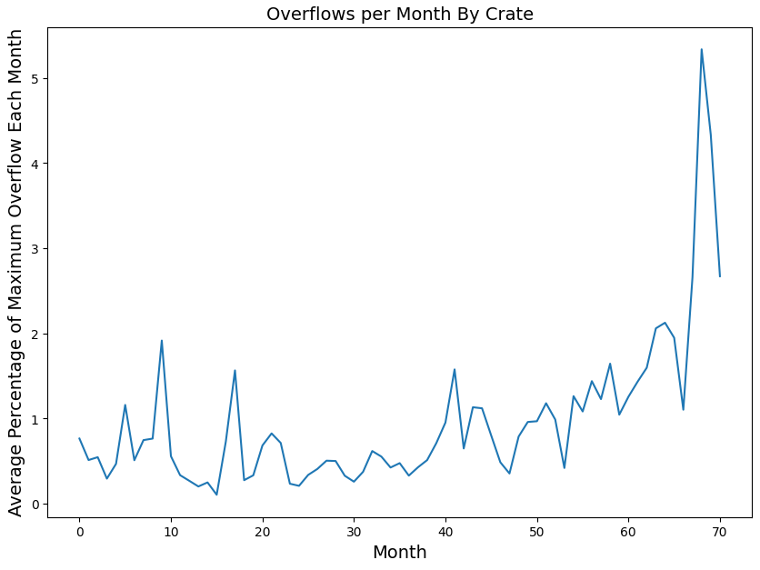
Overflows per Month
Here we see data from January 2019 (month 1) through October of 2024.
This corresponds to the percentage of maximum overflow for each time sample during the month. (Maximum overflows means all 2048 inputs have a counter value of 255 for a given time value).
Over the last 6 years, we average at about 1% of maximum overflow.

Slide 8
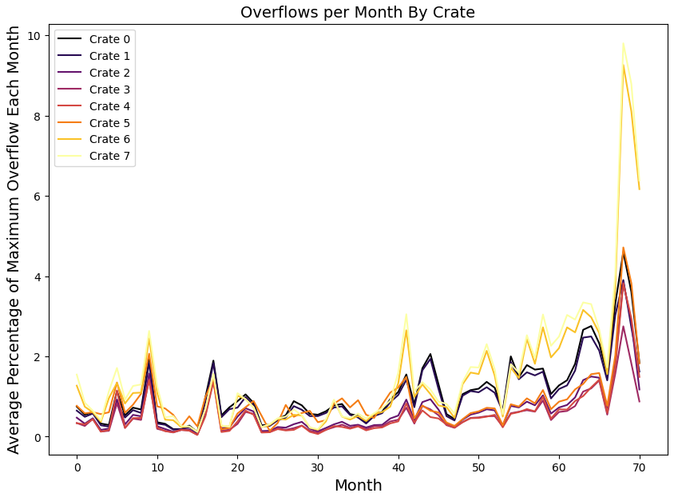
Crate Comparison
Here we see a similar graph as before, but now with data separated out by crate.
All crates have the same general structure, but crates 6 and 7 tend higher than the rest. Especially earlier this year, which was during construction near CHIME.

Slide 9
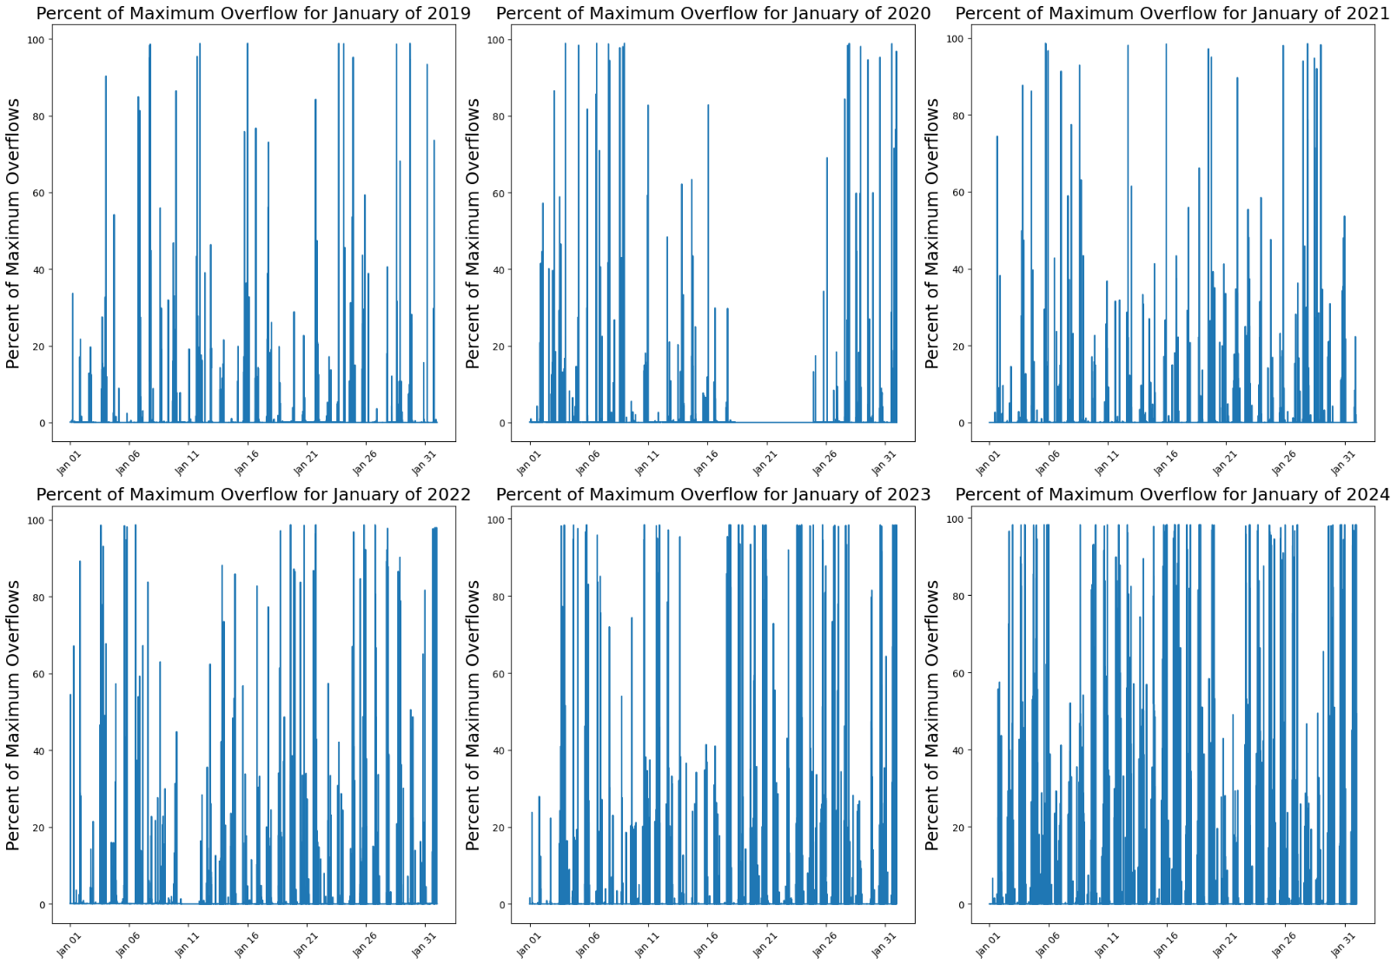
Maximum Overflows Over Time
Here we see data from every January from 2019-2024.
These graphs show the percent of maximum overflows recorded at every time increment over the month.
Overflows seem to be increasing over time.
Notice that there appears to be a pattern to when overflows are highest (most visible in the more recent years). More on this in the next slides.
Long flat portions like in 2020 are due to telescope maintenance.

Slide 10
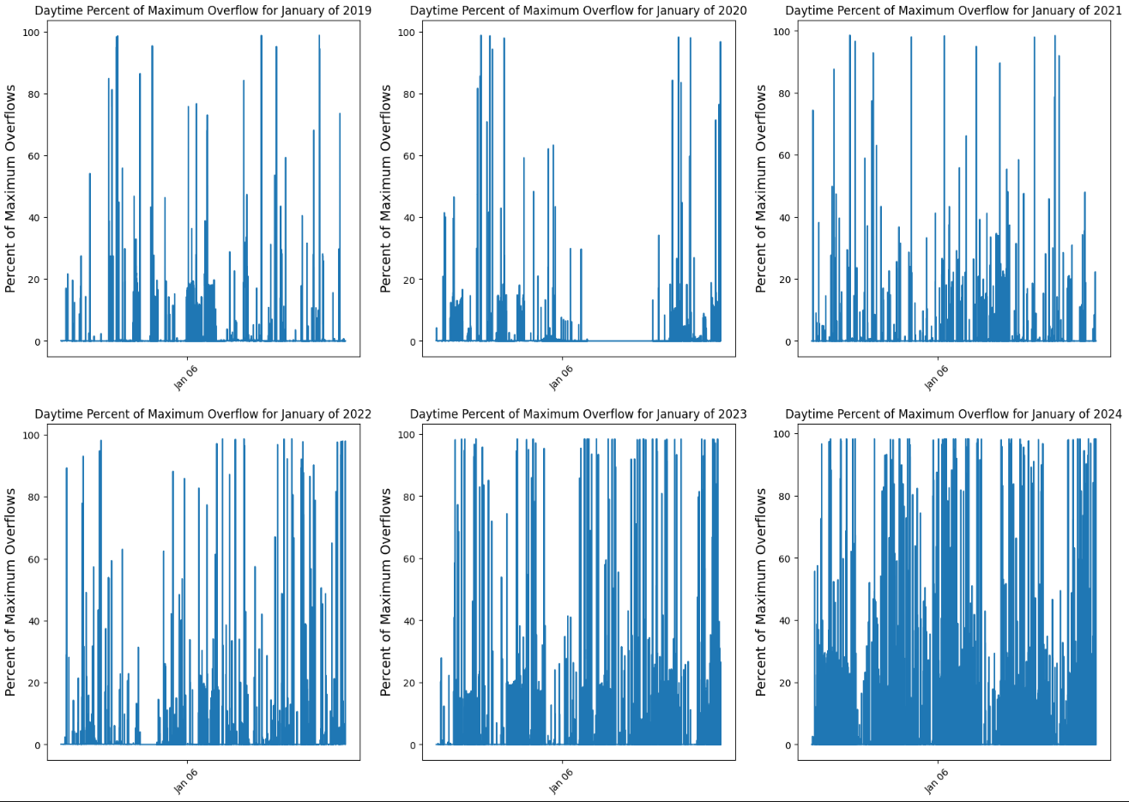
Day Graphs
Here we see the same graphs as before, but only during the daytime.

Slide 11
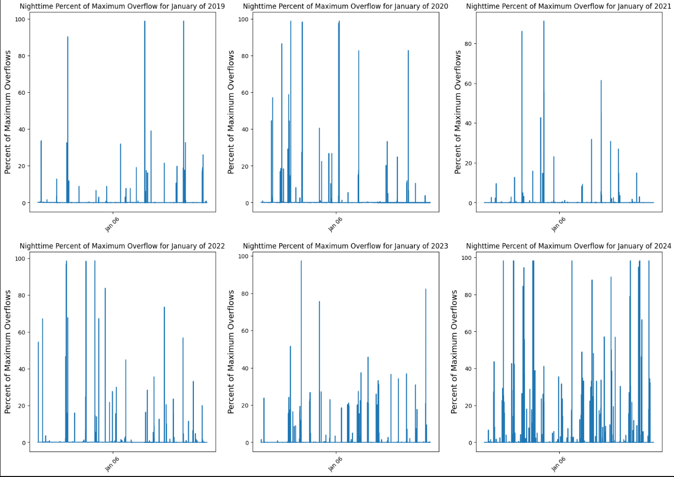
Night Graphs
Now the nighttime data. There are much fewer overflows recorded at night.

Slide 12
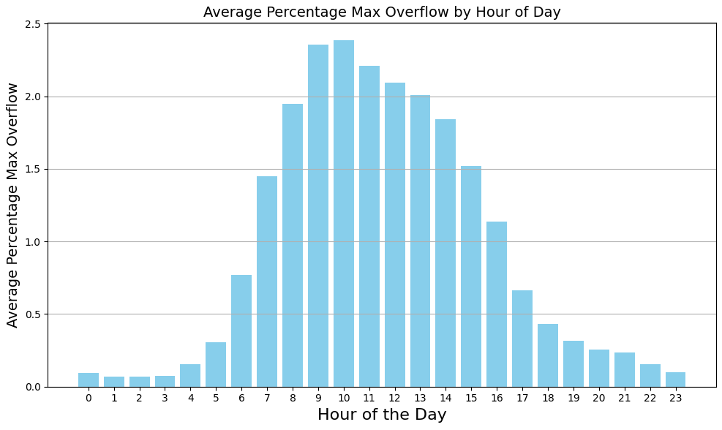
Time of Day (in PST)
Overflow events seem to occur more during the day, but when do they occur?
This graph also shows percentage of maximum overflow at every hour of the day.
The graph peaks during the day, and is consistently low overnight.

Slide 13
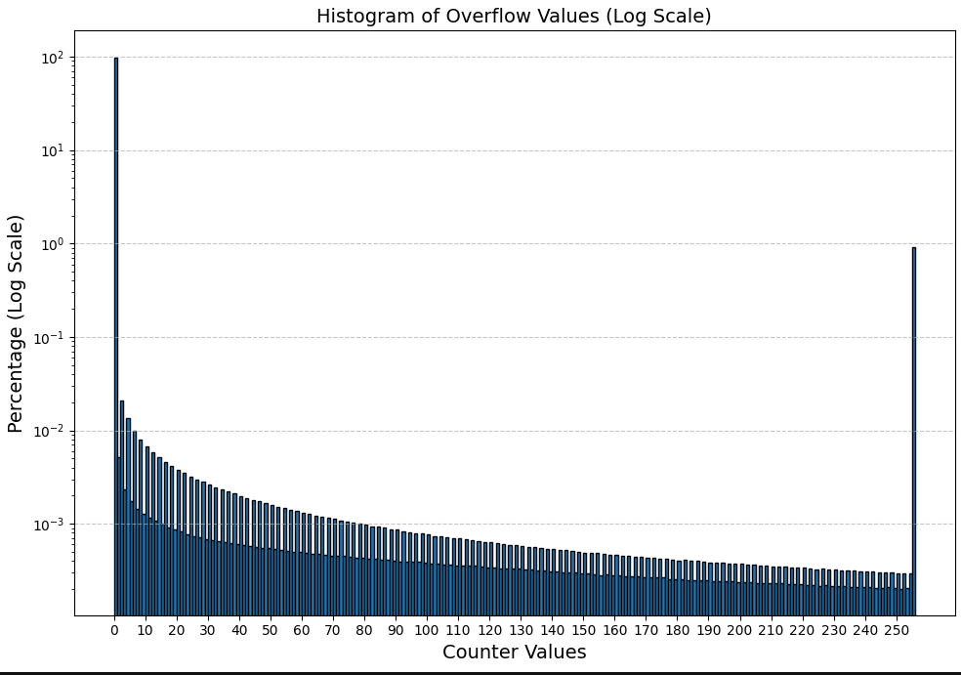
Counter Values
Unsurprisingly, the most common counter value is 0, at ~98.8% of counter values (meaning no overflow), and the second most common is 255, with ~0.9% of counter values. The remaining values, 1-254 all account for only 0.3% of counter values.
Strangely, the counter is more often even values.

Slide 14
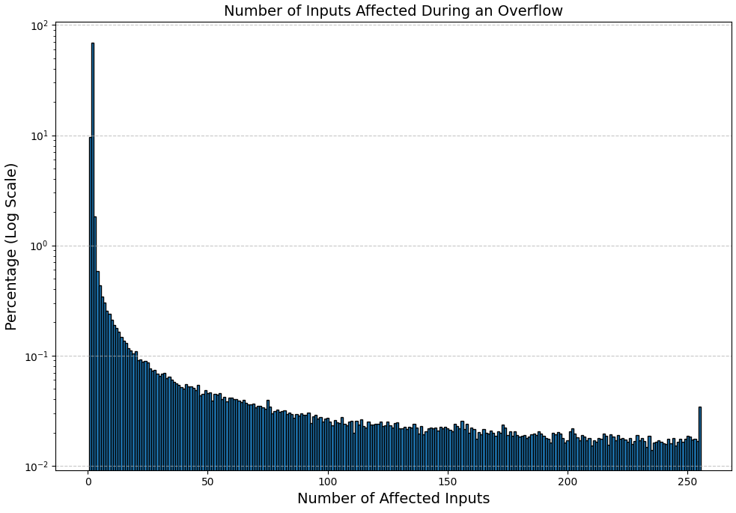
Number of Inputs in Overflow Events
When an overflow happens, how many inputs are affected?
Most overflows occur on just a few inputs.
There is also a slight peak at 256, when every input is affected.

Slide 15
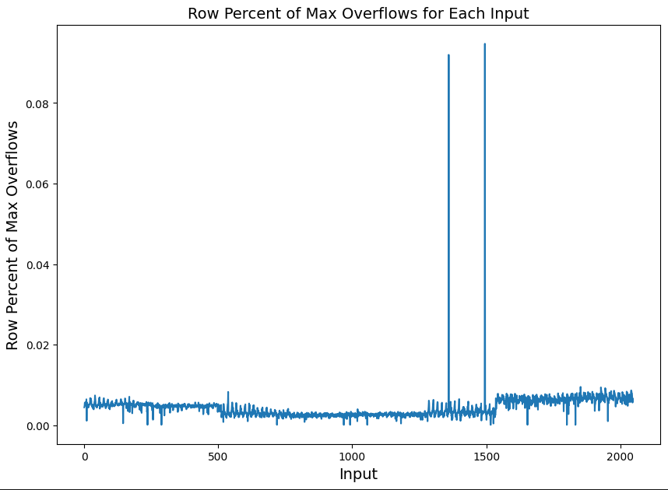
Overflows on Each Input
If Instead of Analyzing each time value, we look at each input individually, (ie change which axis we analyze) we notice that generally, all inputs have a consistently low value of maximum overflow, except for two values, both from Crate 5.

Slide 16
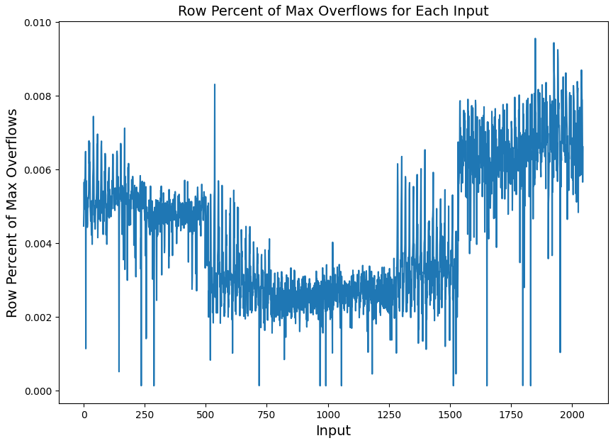
Overflows on Each Input
Removing the two obvious outliers, we get a much more consistent distribution, although there is still plenty of variation between inputs on a small scale.

Slide 17
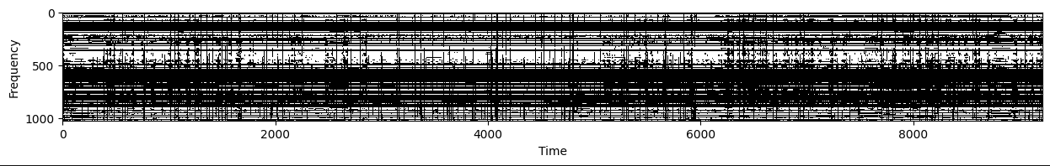
RFI and FFT Overflows
Why do FFT Overflows happen? Maybe because of RFI (Radio Frequency Interference).
The goal now is to find all times which are contaminated with RFI and determine if there are more FFT Overflows than average at those times.
For most days, CHIME keeps RFI Masks in Cedar. They are Boolean arrays with axis of frequency and time. There are 1024 frequencies, and the time values are ~9.95 seconds apart.
This is what a mask looks like for Jan 1, 2019. The black values are bad/contaminated, and white are good.
What we care about are the vertical strips of black. Specific time values where there is lots of RFI.

Slide 18
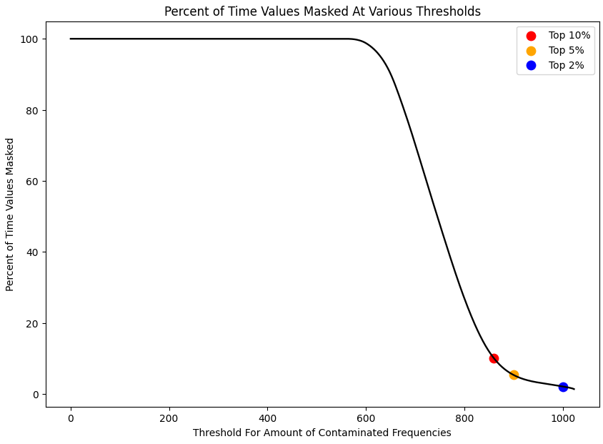
When is a Time Value Contaminated
We need to set a threshold for how many frequencies are considered bad before the whole time is considered contaminated.
Most time values are roughly 60% contaminated, those aren’t interesting.
The ones with much more contamination are the ones which have specific RFI events, which is what we want to consider.
I’ve chosen to explore thresholds at 860,900 and 1000 frequencies labeled bad, which correspond to the top 10%, 5% and 2% most contaminated times.

Slide 19
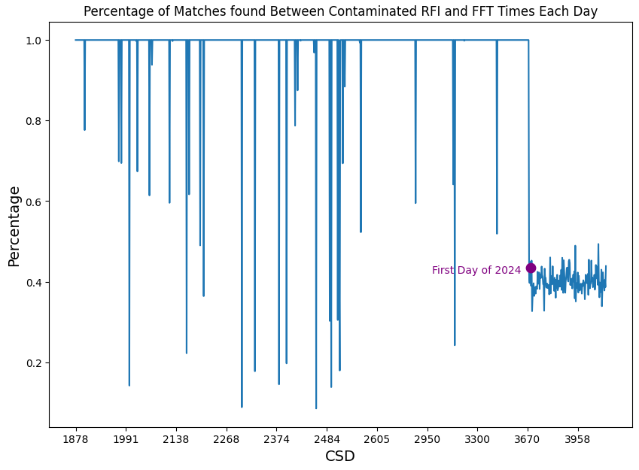
Correlating RFI and FFT Times
Armed with a list of all the times that RFI is contaminated, we want to know what the FFT data looks like at those points. So, we need to match bad RFI data to FFT data and look at only that FFT data.
Here we see the percentage of RFI data matched with FFT data each day. Most days have 100% match, a few outliers here and there, except for the entirety of 2024.

Slide 20
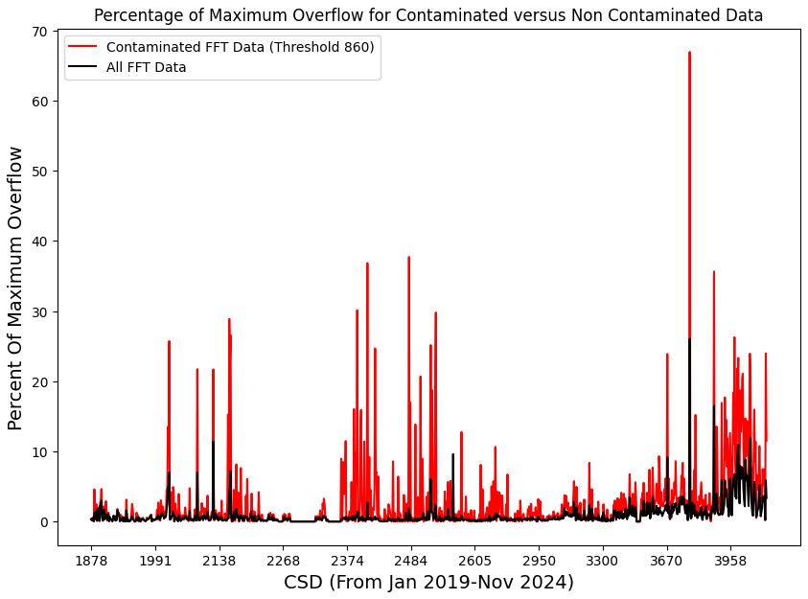
Contaminated vs Non- Contaminated Data
Daily Average Percentage of Maximum Overflow for Contaminated Data (Red) vs Non-Contaminated Data (Black)
Here, we look at the data on FFT overflows for contaminated vs non contaminated data.
The non contaminated data is the exact same as seen in previous slides.
The contaminated data is only the data correlating to times with contaminated FFT data.
The daily average percent max overflow is much higher when only considering contaminated time samples.

Slide 21
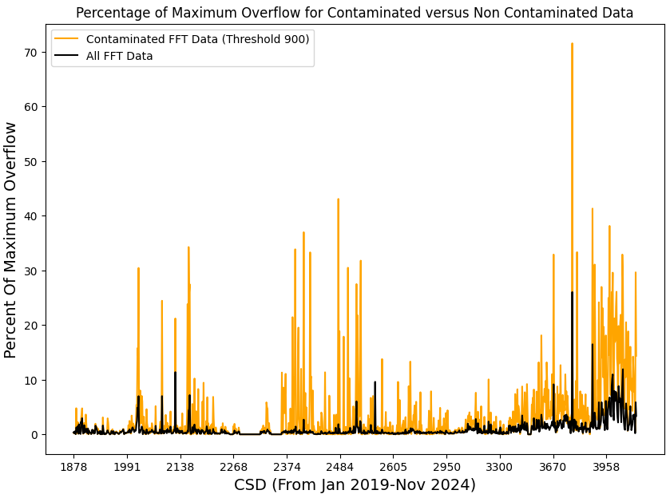
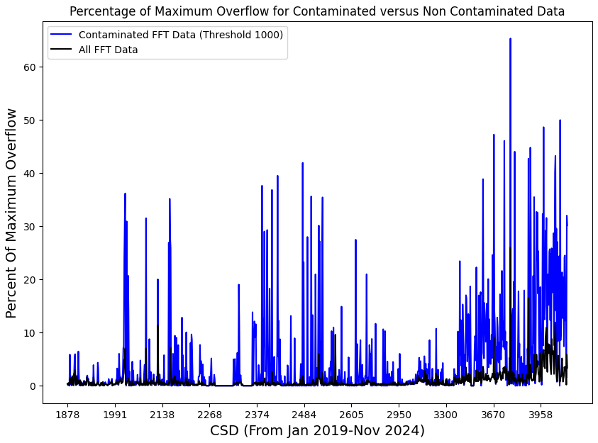
More Contaminated vs Non-Contaminated
Here, we see the same plots as before, but with higher thresholds, meaning the contaminated time values are more contaminated than the previous slides. (And blue is more contaminated than orange)
Daily Average Percentage of Maximum Overflow for Contaminated Data (Orange) vs Non-Contaminated Data (Black)
Daily Average Percentage of Maximum Overflow for Contaminated Data (Blue) vs Non-Contaminated Data (Black)

Slide 22
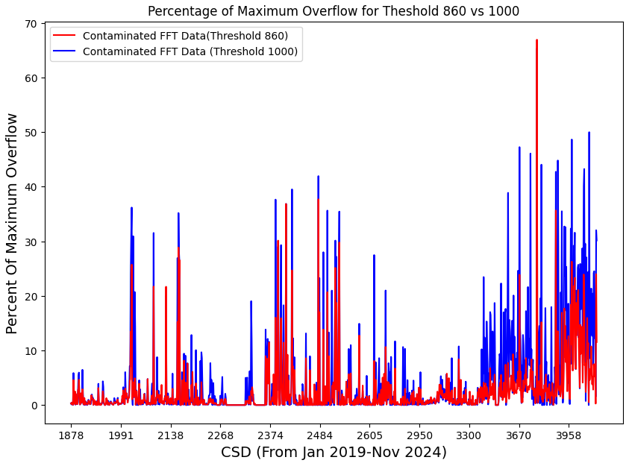
Strongly vs. Weakly Contaminated Time Samples
Daily Average Percentage of Maximum Overflow for Contaminated Data at Threshold 860 and 1000
Our various threshold values are how contaminated a time value needs to be before we classify the whole thing as contaminated.
Comparing the percent of maximum overflow for the time samples contaminated vs strongly contaminated, we see that there are consistently more overflows for the more strongly contaminated data.

Slide 23
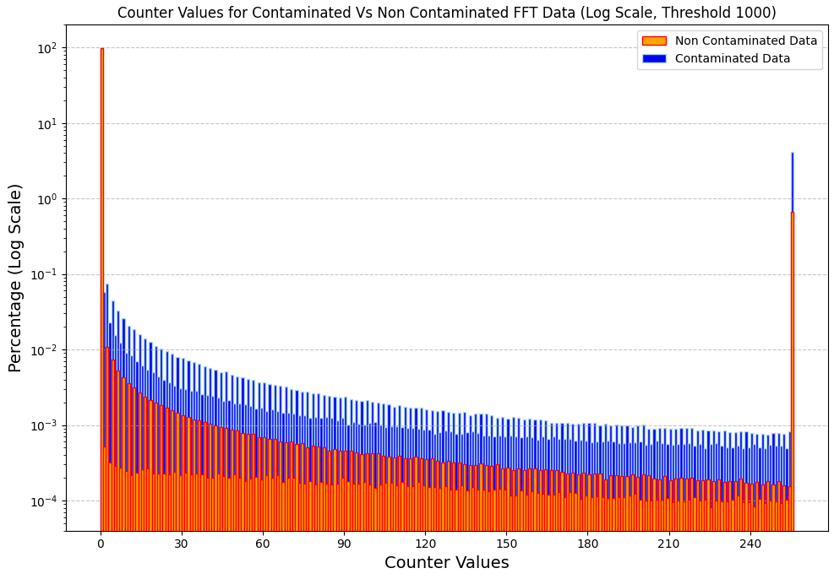
Counter Values for Contaminated and Non Contaminated Data
We expect contaminated data to have more overflows, and more overflows which saturate the counter value.
That is exactly what happens here.

Slide 24
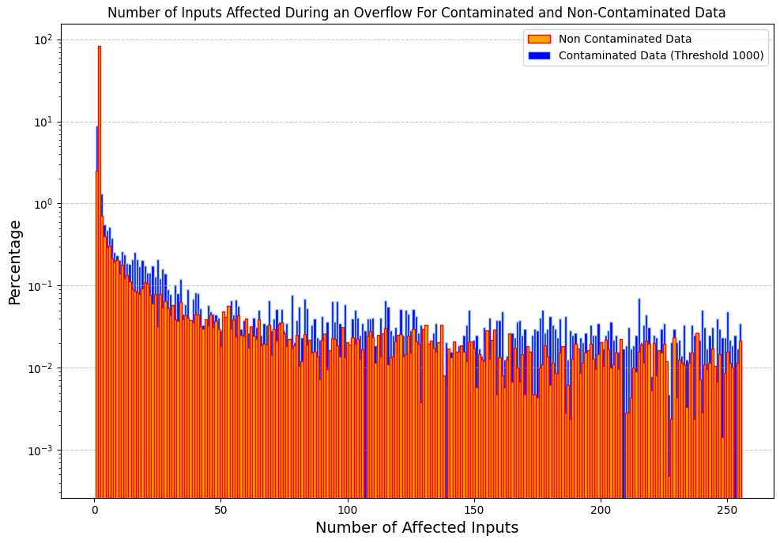
Number of Inputs Affected During an Overflow for Contaminated and Non-Contaminated Data
We notice that contaminated data more often overflows on more inputs.
But still usually only overflows on a few inputs.

Slide 25
What about the Other Direction?
We’ve seen that FFT Overflows are somewhat increased at times with high levels of RFI.
What does RFI data look like at times with FFT Overflows?

Slide 26
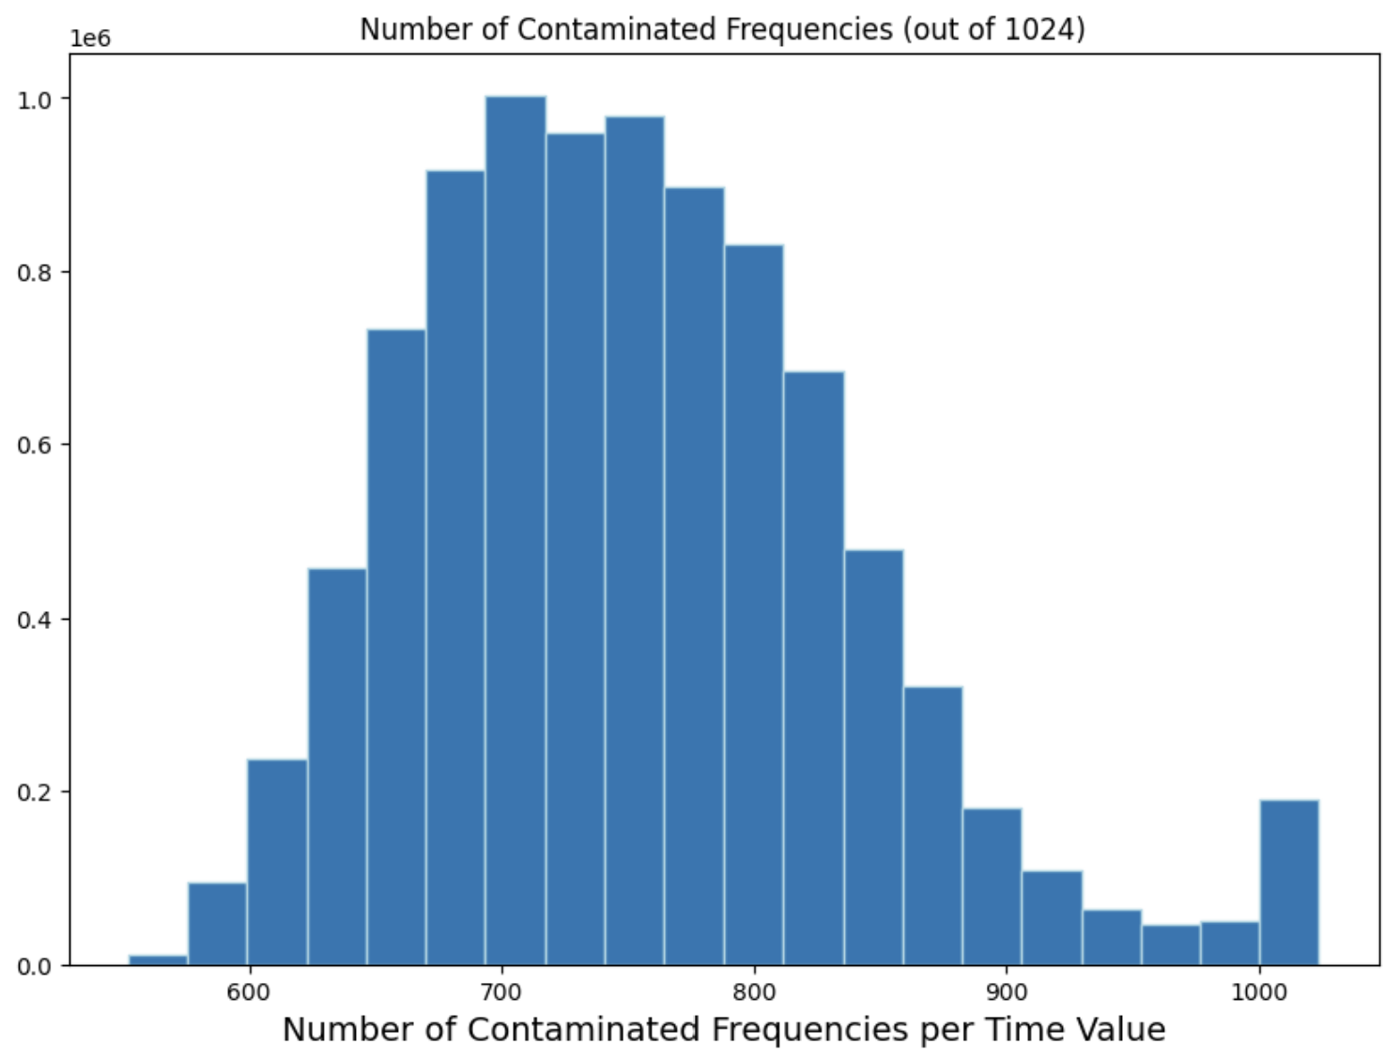
Regular RFI Data
Here, we see a histogram over the number of masked frequencies each time sample.
The average amount of masked samples for a given time value is about 750, and it’s standard deviation is 85.

Slide 27
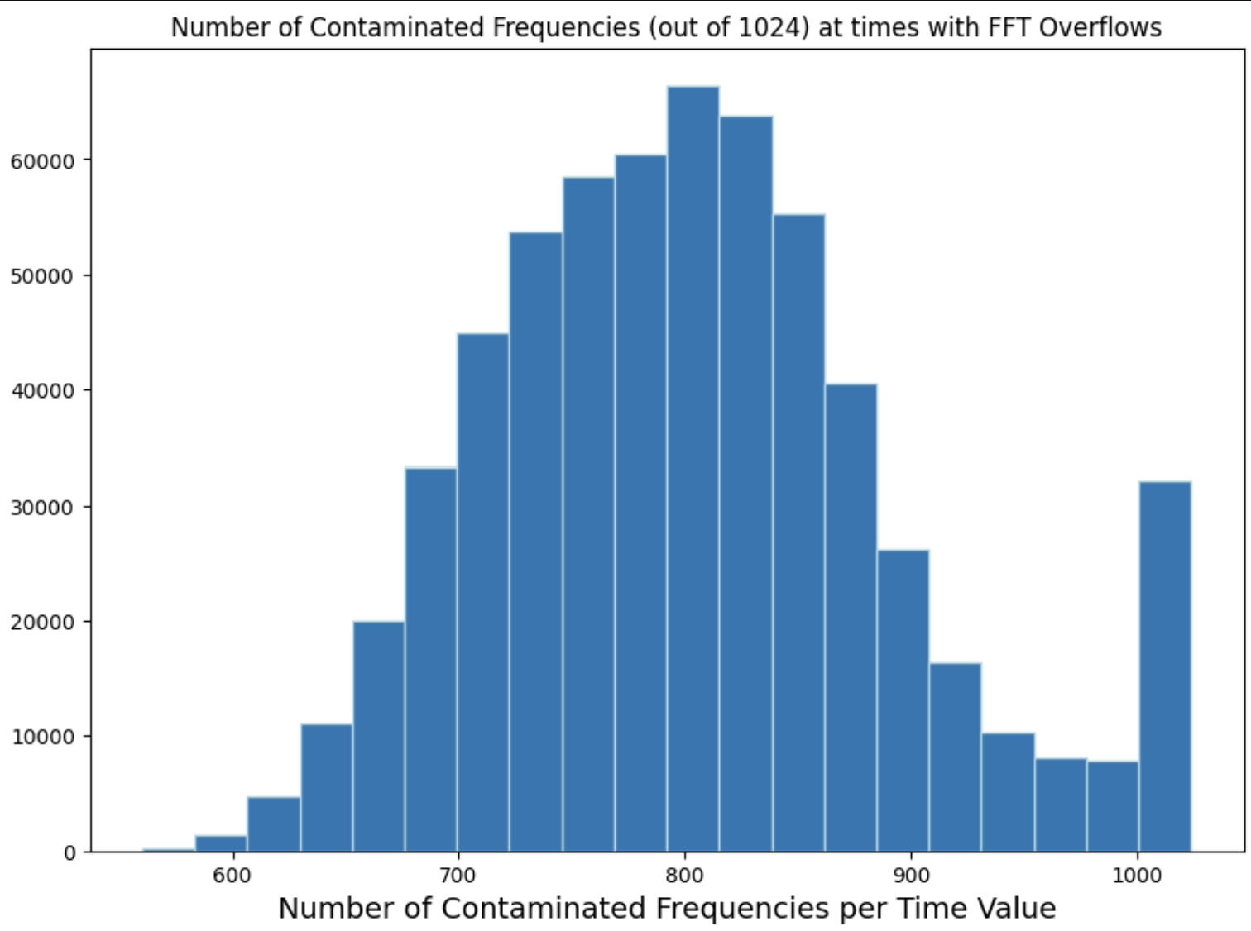
RFI Data at Times with FFT Overflows
Now, we see the same histogram, but only for times that record at least one FFT Overflow.
The average amount of masked frequencies is now 800, with a standard deviation of 90.

Slide 28
Misc Things to Note/Work on Later
Percentage of NAN for all data: 10%
Percentage of NAN for 860: 4%, 900: 2%, 1000: 1%. Higher RFI cutoff correlates with less nan values. Cool?
Figure out why 2024 fft and rfi data don’t match very well more
Add the two histograms for FFT to RFI

